Slide 1
Iowa Housing Market Group
Supervised Team Application Development
Summer 2019

Slide 2
Who Are We?
All CS majors in junior/senior years!
Arman Berek
Daniel Mallia
Jinxiu Liu
Muskan Kapoor
Yiheng Cen Feng

Slide 3
Introduction of our Project
Interested in the machine learning & data science experience. There is a lot of intuition to develop!
Wanted to develop an end product with a fun, user friendly web interface.
Focus is on a real estate price prediction website: you give us the features, we give you an estimate.
We aim to include visualizations and multiple kernels which demonstrate our thinking and work processes.

Slide 4
The Process
Setting a goal, an “end product.”
Choosing a data set:
Iowa’s vs Brooklyn’s
What opportunities lie in the dataset.
Reviewing and cleaning the data.
Create a web app with multiple kernels and a form for user input; the prediction model is the backbone that provides an answer for the user.

Slide 5
Why use an Ames, Iowa dataset?
More useful features = better prediction
More “user-intuitive”, logical and usable data
Credible dataset (sourced from Kaggle)
Good size (1460 rows x 81 columns)
NYC needs a good analogous dataset!

Slide 6
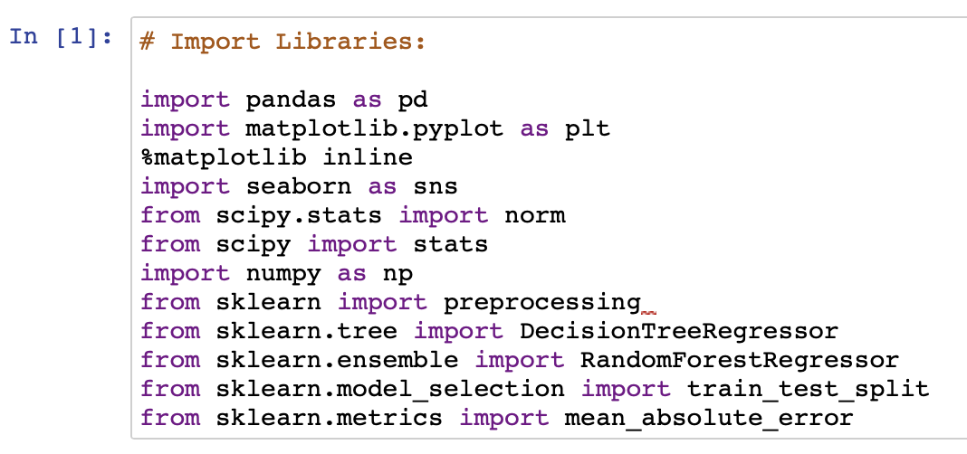
Language and Stack
Data Science Language: Python, particularly the following libraries:
Pandas: data extractions and preparations (reading the data)
Matplotlib: data visualization
Seaborn: data visualization
Numpy: statistical feature (correlation, median, mean)
Sklearn: ML algorithms (linear regression, random forest regression, one hot encoder, get dummies)
Platforms: Jupyter Notebook → CoCalc
Web Stack:
HTML / CSS: Front end (web outline and design)
Flask: Back end

Slide 7
Reviewing and Cleaning the Data:
Missing values - rows and columns:
Removing rows and columns
Imputation
Imputation with extension
For that which remain:
binarization
create derived features?
Binning/quantization
Quantitative Data:
Normalizations/transformations
Qualitative Data [Categorical]:
One-hot encoding / dummy encoding

Slide 8
Machine Learning Models:
Decision Tree
Random Forests
XGBoost
Other models:
Linear, Ridge, Lasso regression, Neural Net

Slide 9
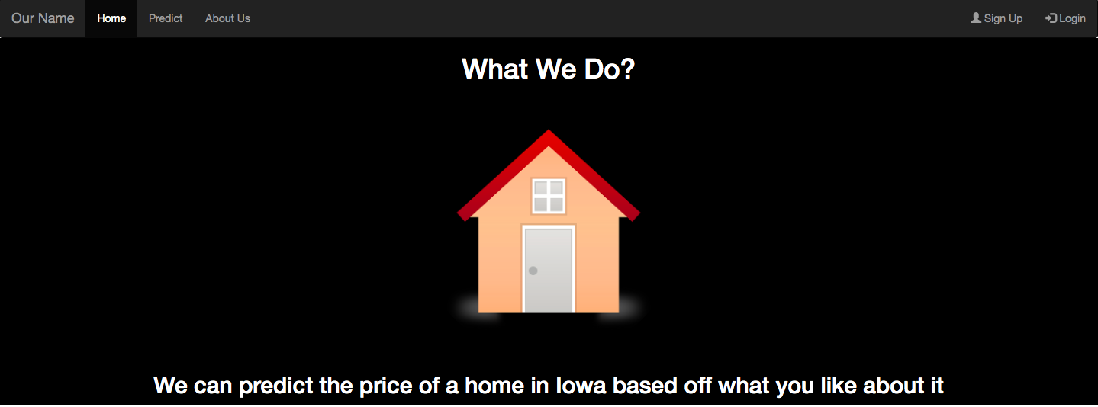
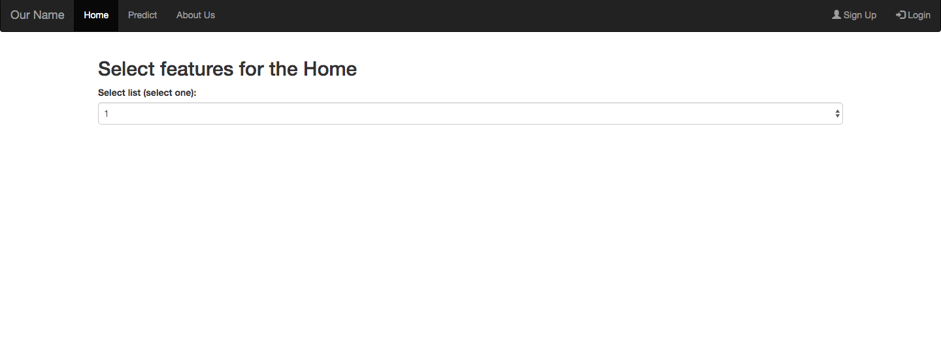
End Product
Interactive web application
Predictive model

Slide 10
Learning sources
Kaggle (practical)
Bloomberg (theoretical)
Github
YouTube
Google

